Slide 1
Data processing for tumor and t-cell detections
Yannis laaroussi
Bachelor thesis – initial presentation

Slide 2
motivation
Link between biology/medicine and computer science
Learn python
Manipulate data
Notes:
Explain why I chose this topic.

Slide 3
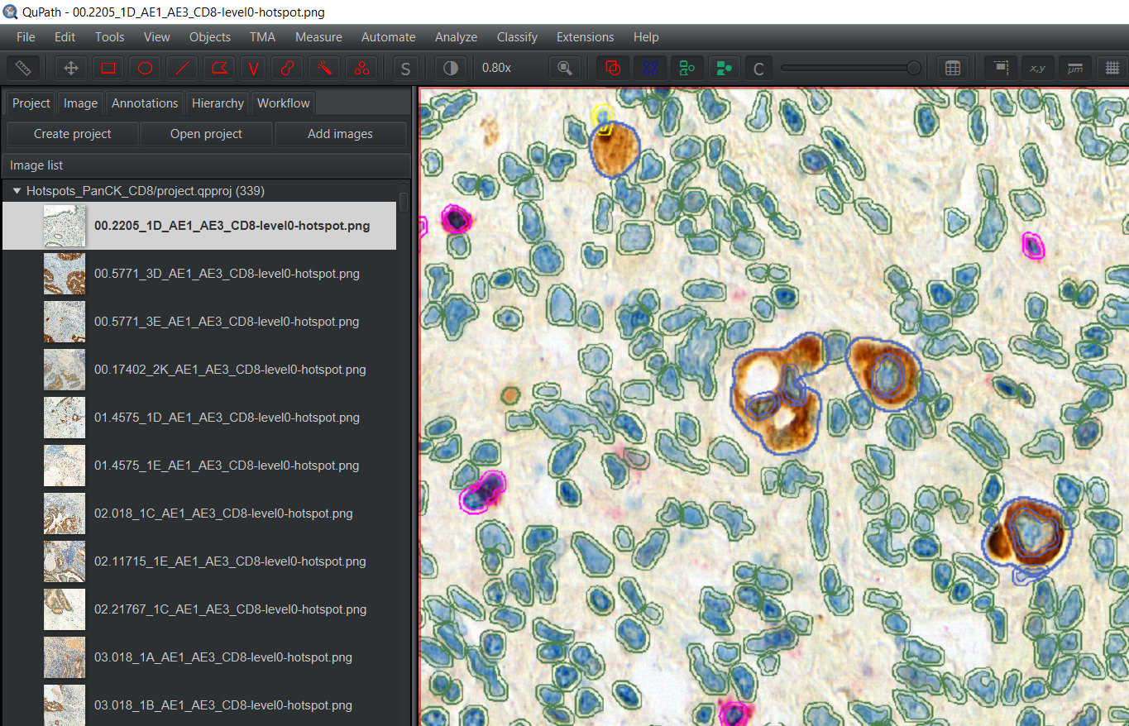
qupath
Tumor buds
(brown spot)
Bounded by polygons
Notes:
Explain purpose of QuPath : software to visualize particular region. Tumor, Cells, bounded by polygons. Also we have some information about each cells like perimeter, area, …

Slide 4
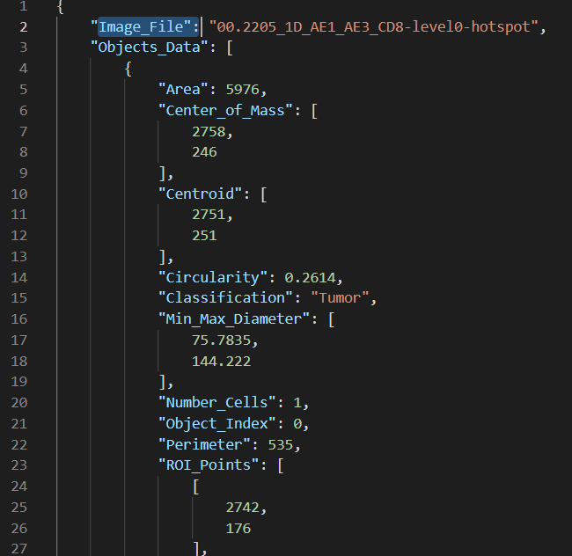
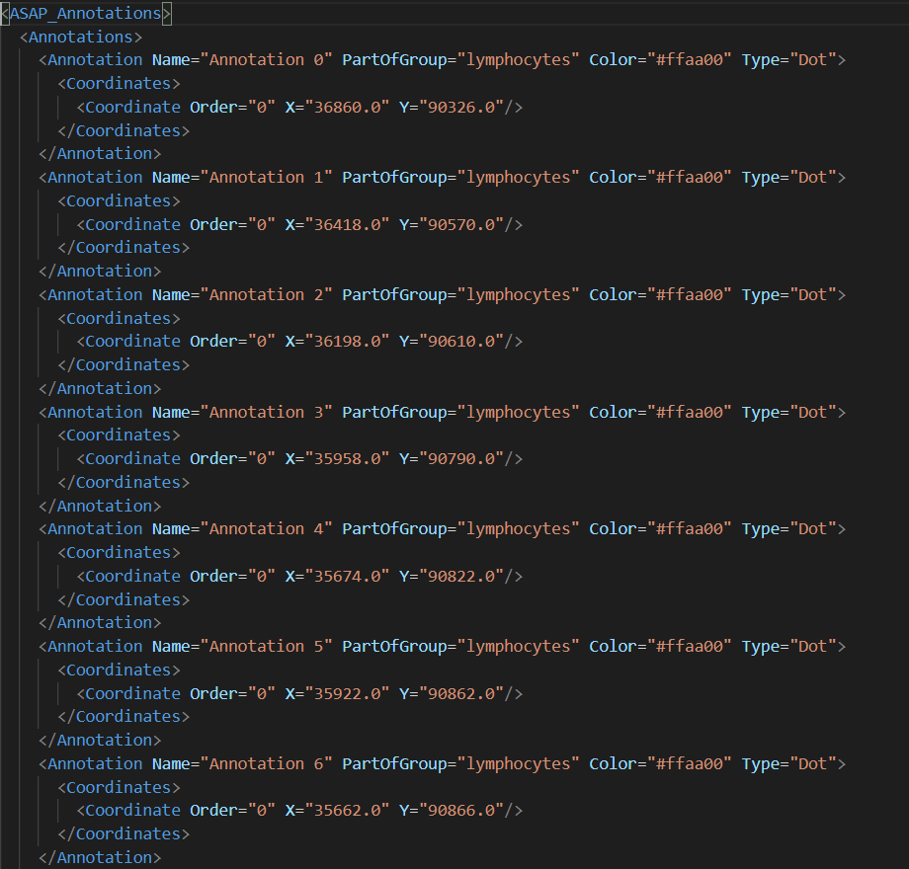
goal
JSON file (from QuPath)
XML file
Python Script
Notes:
Goal of the project, transform json file where we can fin information

Slide 5
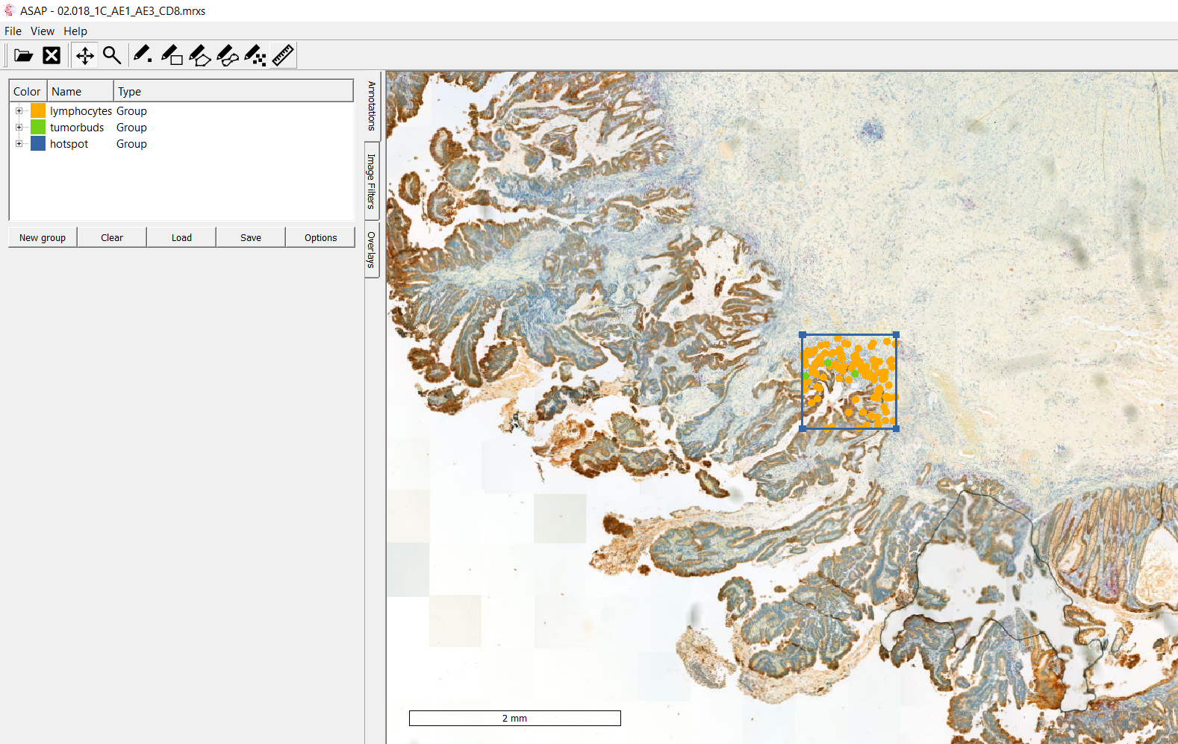
Asap
Visualisation using xml file
Notes:
Second software asap to use xml file in order to see on a full medical picture a particular hotspot

Slide 6

excel
JSON file to .CSV
Python Script
Notes:
Second part : convert json file in .csv file in order to visualize data on an excel sheet

Slide 7
Timeline
Preparation/Introduction to the subject | 21.02.2022 – 06.03.2022 | 3 weeks
Part 1 : JSON to XML | 07.03.2022 – 27.03.2022 | 3 weeks
Part 2 : JSON to EXCEL | 28.03.2022 – 17.04.2022 | 3 weeks
Part 3 : Writing | 18.04.2022 – 22.05.2022 (+ summer if needed) | 5 weeks

Slide 8
Questions ?

